Slide 1
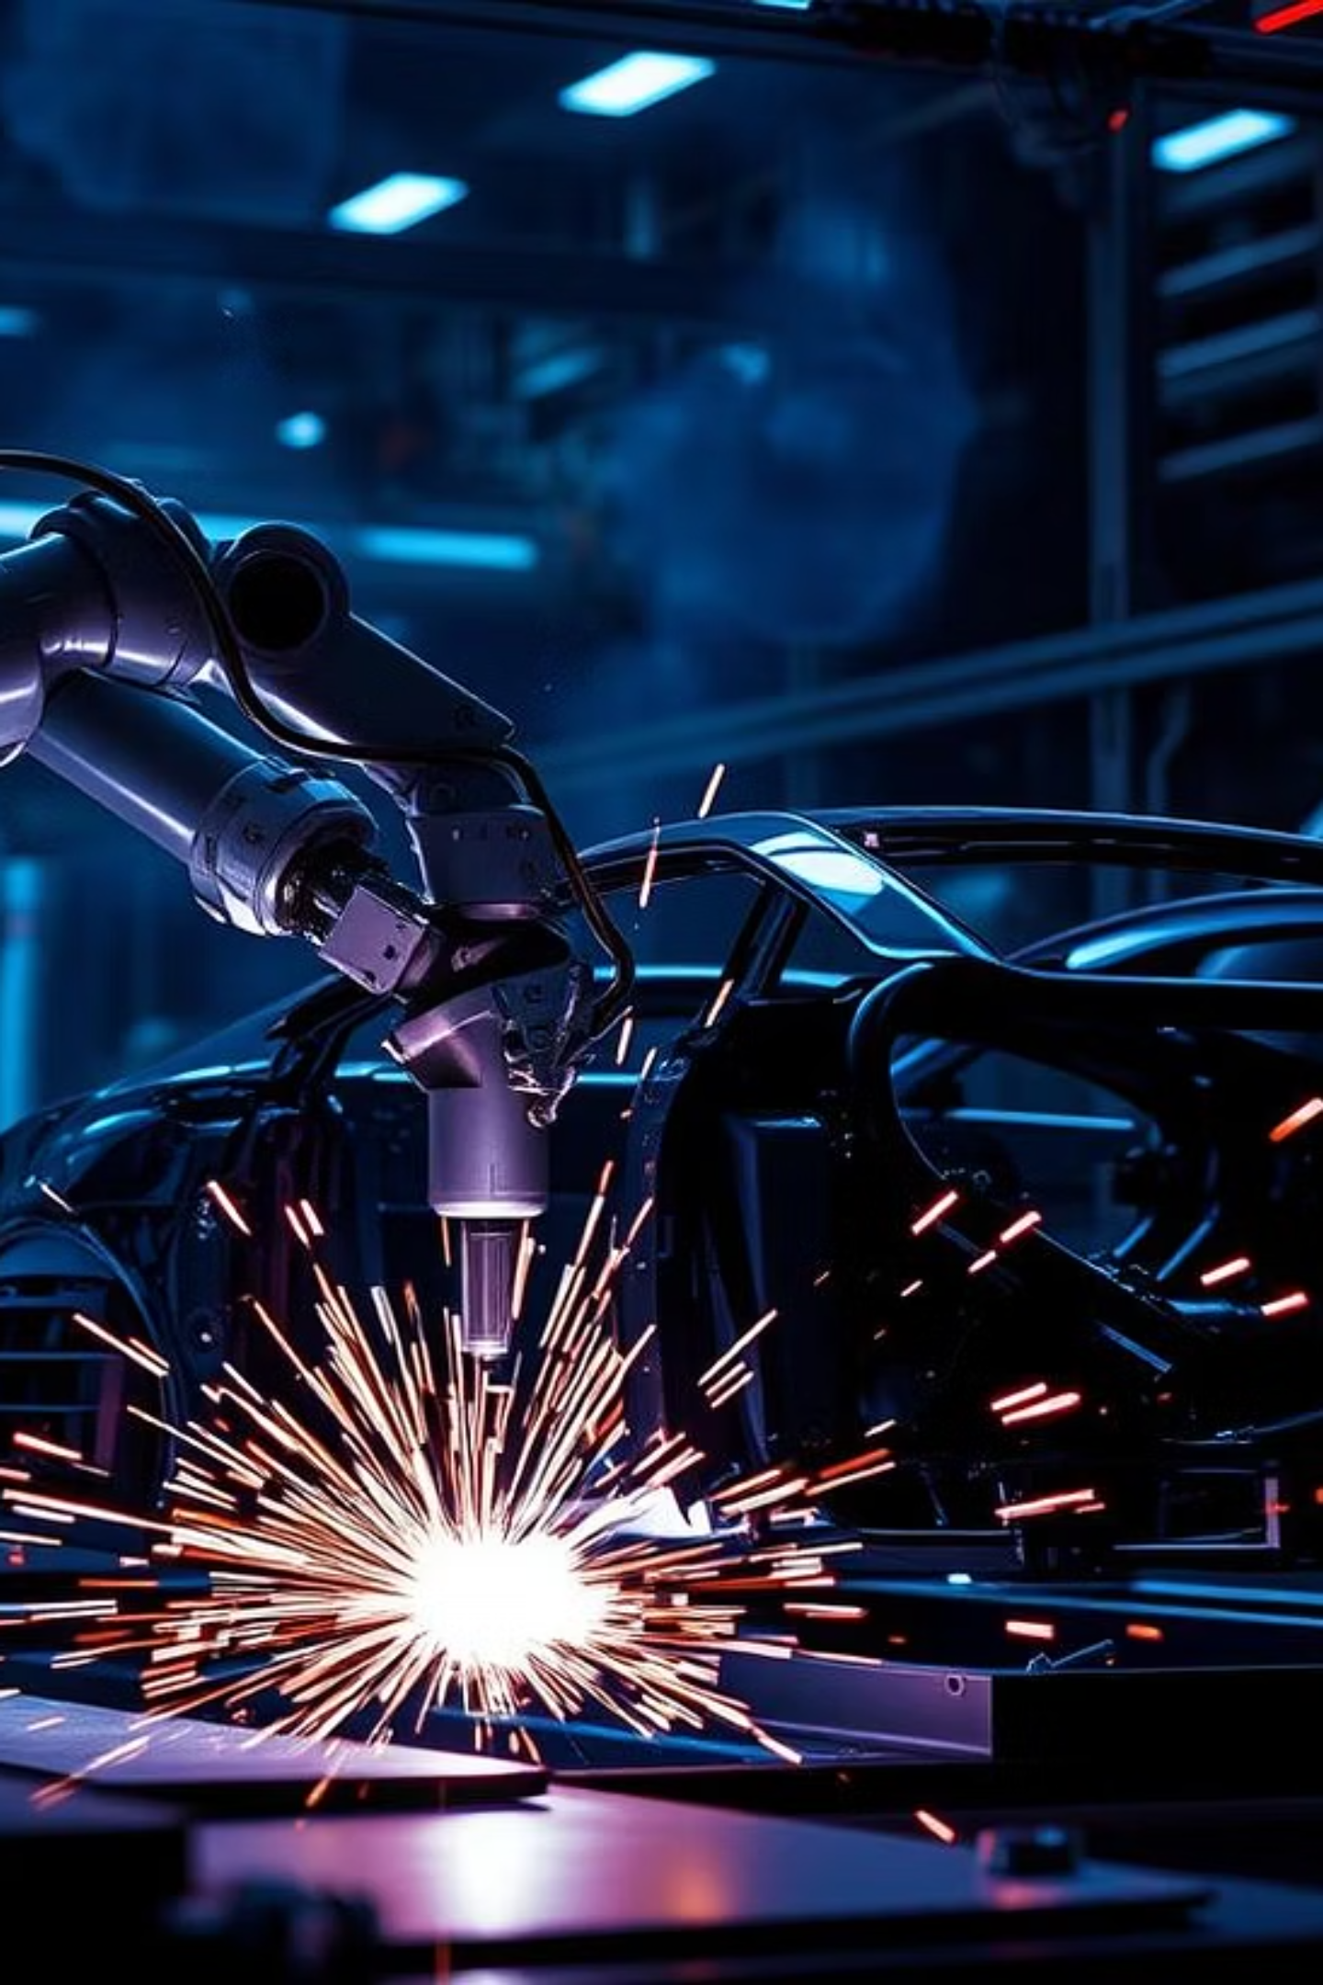

The World of Industrial Robots: From Design to Deployment
This presentation explores the fascinating realm of industrial robots, delving into their diverse types, intricate components, and the advanced technologies that enable their seamless operation in modern manufacturing and beyond.

Slide 2
Types of Industrial Robots
1
Articulated Robots
1
Collaborative Robots (Cobots)
The most common type, with 2-10 rotary joints, mimicking a human arm's dexterity. They excel in tasks like welding and packaging, holding over 60% of the market share.
Designed for safe human-robot interaction, cobots work alongside human operators, offering flexibility and ease of deployment in various industrial settings.
2
Cartesian Robots
2
Mobile Robots
Operating on linear X, Y, and Z axes, these robots offer high precision and a large workspace, making them cost-effective for applications requiring linear movement.
These autonomous robots navigate factory floors, transporting materials and goods, significantly improving logistics and efficiency in manufacturing facilities.
3
SCARA Robots
Known for their fast and accurate lateral motion, SCARA (Selective Compliance Assembly Robot Arm) robots are ideal for assembly tasks and pick-and-place operations.

Slide 3
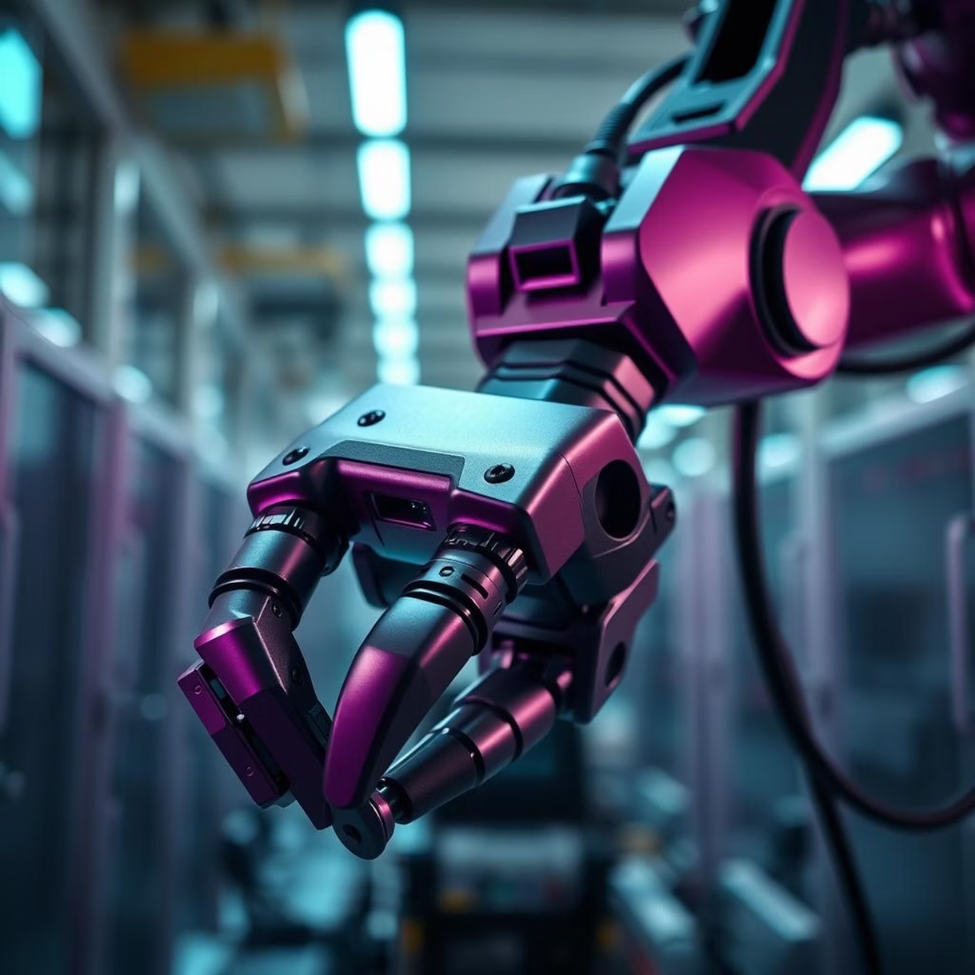
Components of Industrial Robots: Hardware + Software
Manipulator: The robotic arm, composed of joints and links, driven by electric, pneumatic, or hydraulic actuators.
End Effectors: Specialized tools attached to the arm's end, such as grippers, welders, or sensors, tailored for specific tasks.
Feedback Devices: Encoders and potentiometers provide crucial data on joint position and velocity, ensuring precise control.
Controller: The "brain" of the robot, combining hardware and software to execute complex motion control and path planning algorithms.
Sensors: Vision systems, tactile sensors, and LIDAR enable the robot to perceive its environment, critical for autonomous operation and interaction.

Slide 4




Real-time Control Challenges & Latency
Control Loop Frequency
Latency Sources
Industrial robots typically operate at control loop frequencies of 1 kHz to ensure smooth and precise motion control.
Delays from sensor data acquisition, processing, and communication lag can significantly impact robot performance.
Impact of Delays
Solutions
Even slight latency can lead to instability, tracking errors, and critical safety risks in high-speed operations.
Implementing real-time operating systems, deterministic communication protocols, and predictive control algorithms mitigates these challenges.

Slide 5
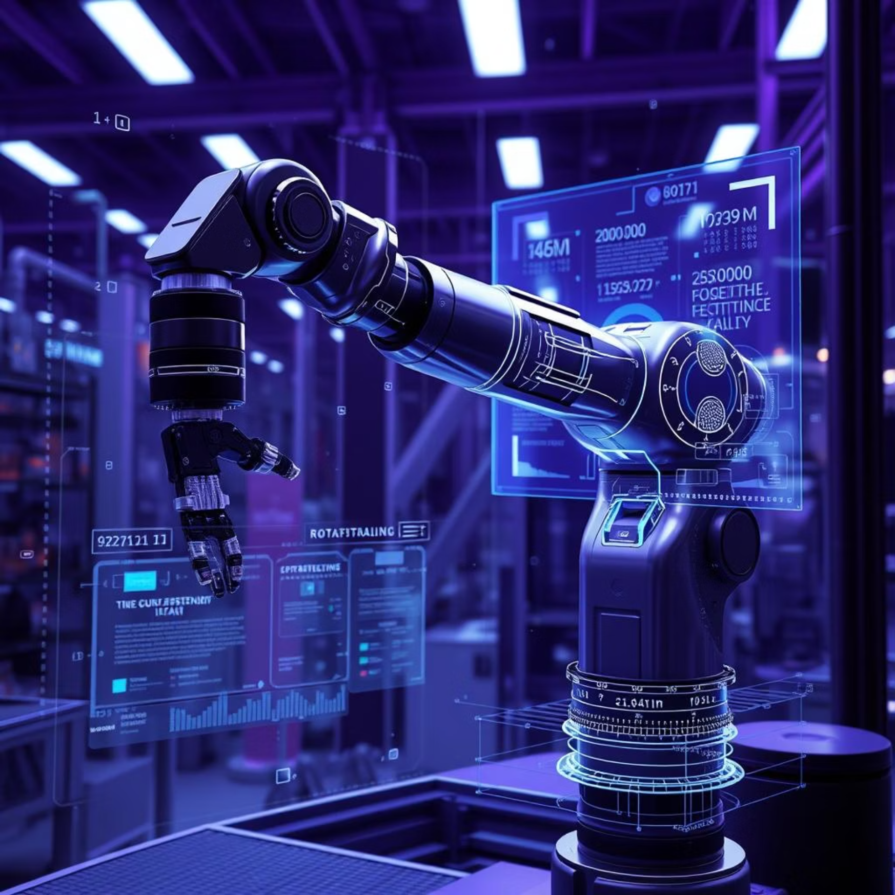
Integration with IIoT and Digital Twins
Industrial IoT (IIoT)
Robots are connected via robust industrial networks, enabling real-time data exchange, remote monitoring, and seamless integration into smart factories.
Digital Twins
Virtual replicas of physical robots that simulate their behavior, allowing for predictive maintenance, performance optimization, and scenario testing.
Increased Uptime: Proactive identification of maintenance needs.
Adaptive Control: Real-time adjustments based on simulated scenarios.
Enhanced Decision-Making: Data-driven insights for operational improvements.
Leading companies like Siemens and ABB leverage digital twins for comprehensive robot lifecycle management.

Slide 6




Challenges in Sensing for Industrial Robots
Vision Systems
Tactile Sensors
Challenges include adapting to varying lighting conditions, handling object occlusions, and accurately tracking high-speed moving objects.
Require high resolution and durability to provide accurate force and pressure feedback for intricate manipulation tasks.
LIDAR
Sensor Fusion
Offers precise 3D mapping but can be sensitive to environmental factors like dust and highly reflective surfaces, affecting data accuracy.
Combining data from multiple sensor types is essential to overcome individual limitations and significantly improve robot autonomy and environmental perception.

Slide 7
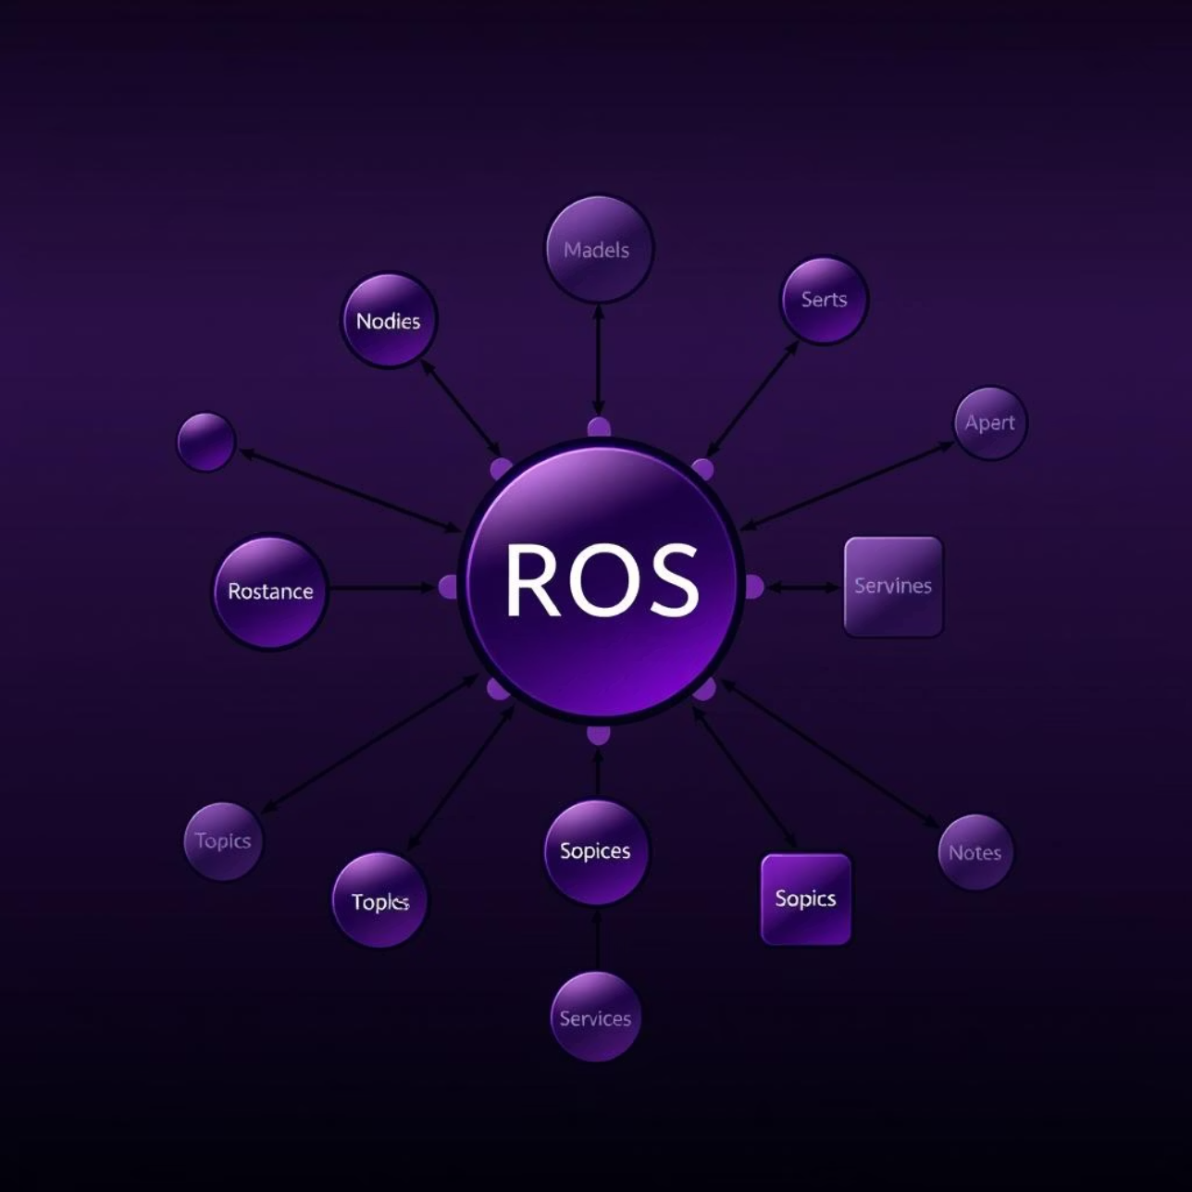
ROS (Robot Operating System) Architecture Explained
ROS is a flexible framework designed to simplify the process of building complex robot software. It enables modular development through:
Nodes: Individual processes that perform specific tasks, such as sensor data processing or motor control.
Topics & Services: Communication mechanisms for nodes to exchange data (topics) and request/provide functionalities (services).
Core Components: Includes the ROS Master (for node registration), Publisher/Subscriber model for data flow, and Service Servers/Clients for interactions.
Packages: Collections of files, including hardware drivers, perception algorithms, planning modules, and simulation tools.
ROS 2 brings significant improvements, offering real-time support and leveraging DDS middleware for enhanced reliability and suitability in industrial applications.

Slide 8

Cybersecurity Risks in Industrial Robots
Increased connectivity exposes industrial robots to significant cybersecurity threats.
Vulnerabilities: Unpatched operating systems, insecure communication protocols, and weak authentication mechanisms create entry points for attackers.
Risks: Beyond data breaches, cybersecurity incidents can lead to intellectual property theft, critical production downtime, and even physical damage to machinery or harm to personnel.
Real-world examples include sophisticated attacks on manufacturing robots that disrupt operations and compromise data integrity, highlighting the urgent need for robust defense strategies.

Slide 9
Best Practices for Cybersecurity in Industrial Robotics
Risk Assessments
Network Segmentation
Updates & Patching
Regularly conduct thorough cybersecurity risk assessments to identify and mitigate potential vulnerabilities in robot systems and networks.
Implement robust network segmentation and secure communication protocols to isolate critical robot systems and prevent unauthorized access.
Ensure all robot firmware and software are consistently patched and updated to protect against known vulnerabilities and emerging threats.
Access Control
Anomaly Detection
Utilize strong identity and access management (IAM) with multi-factor authentication (MFA) to control who can interact with robot systems.
Implement continuous monitoring of robot behavior for anomalies and intrusion detection systems to quickly identify and respond to suspicious activities.

